Slide 1
Where is the Data?
Becca Morgan, Special Collections Archivist
Archivist Roundtable
April 29, 2016
Notes:
These represent different kinds of data that scientists are trying to get a better handle on.
They are developing tools to help make these connections more meaningful.
Field books and Science Archives play a central piece to this effort.

Slide 2
Notes:
Our last grant focused on expeditions.
Expeditions:
What did they bring back?
Specimens and Artifacts
Diaries
Journals
Specimen lists
Photographs
Notes and Sketches
Recorded Sound
Moving Images

Slide 3
What is a field book?
Primary source documents that describe the events leading up to and including the collection of specimens or observations during field research.
Field notes can take many forms depending on the information needs of the collector.

Slide 4
Importance and challenges
Field notes are significant sources of information related to scientific discovery. They provide rich data for researchers to understand how biodiversity has changed over time and space. They enhance information associated with specimens by providing details regarding dates, localities (for geo-referencing), and associated event data.

Slide 5
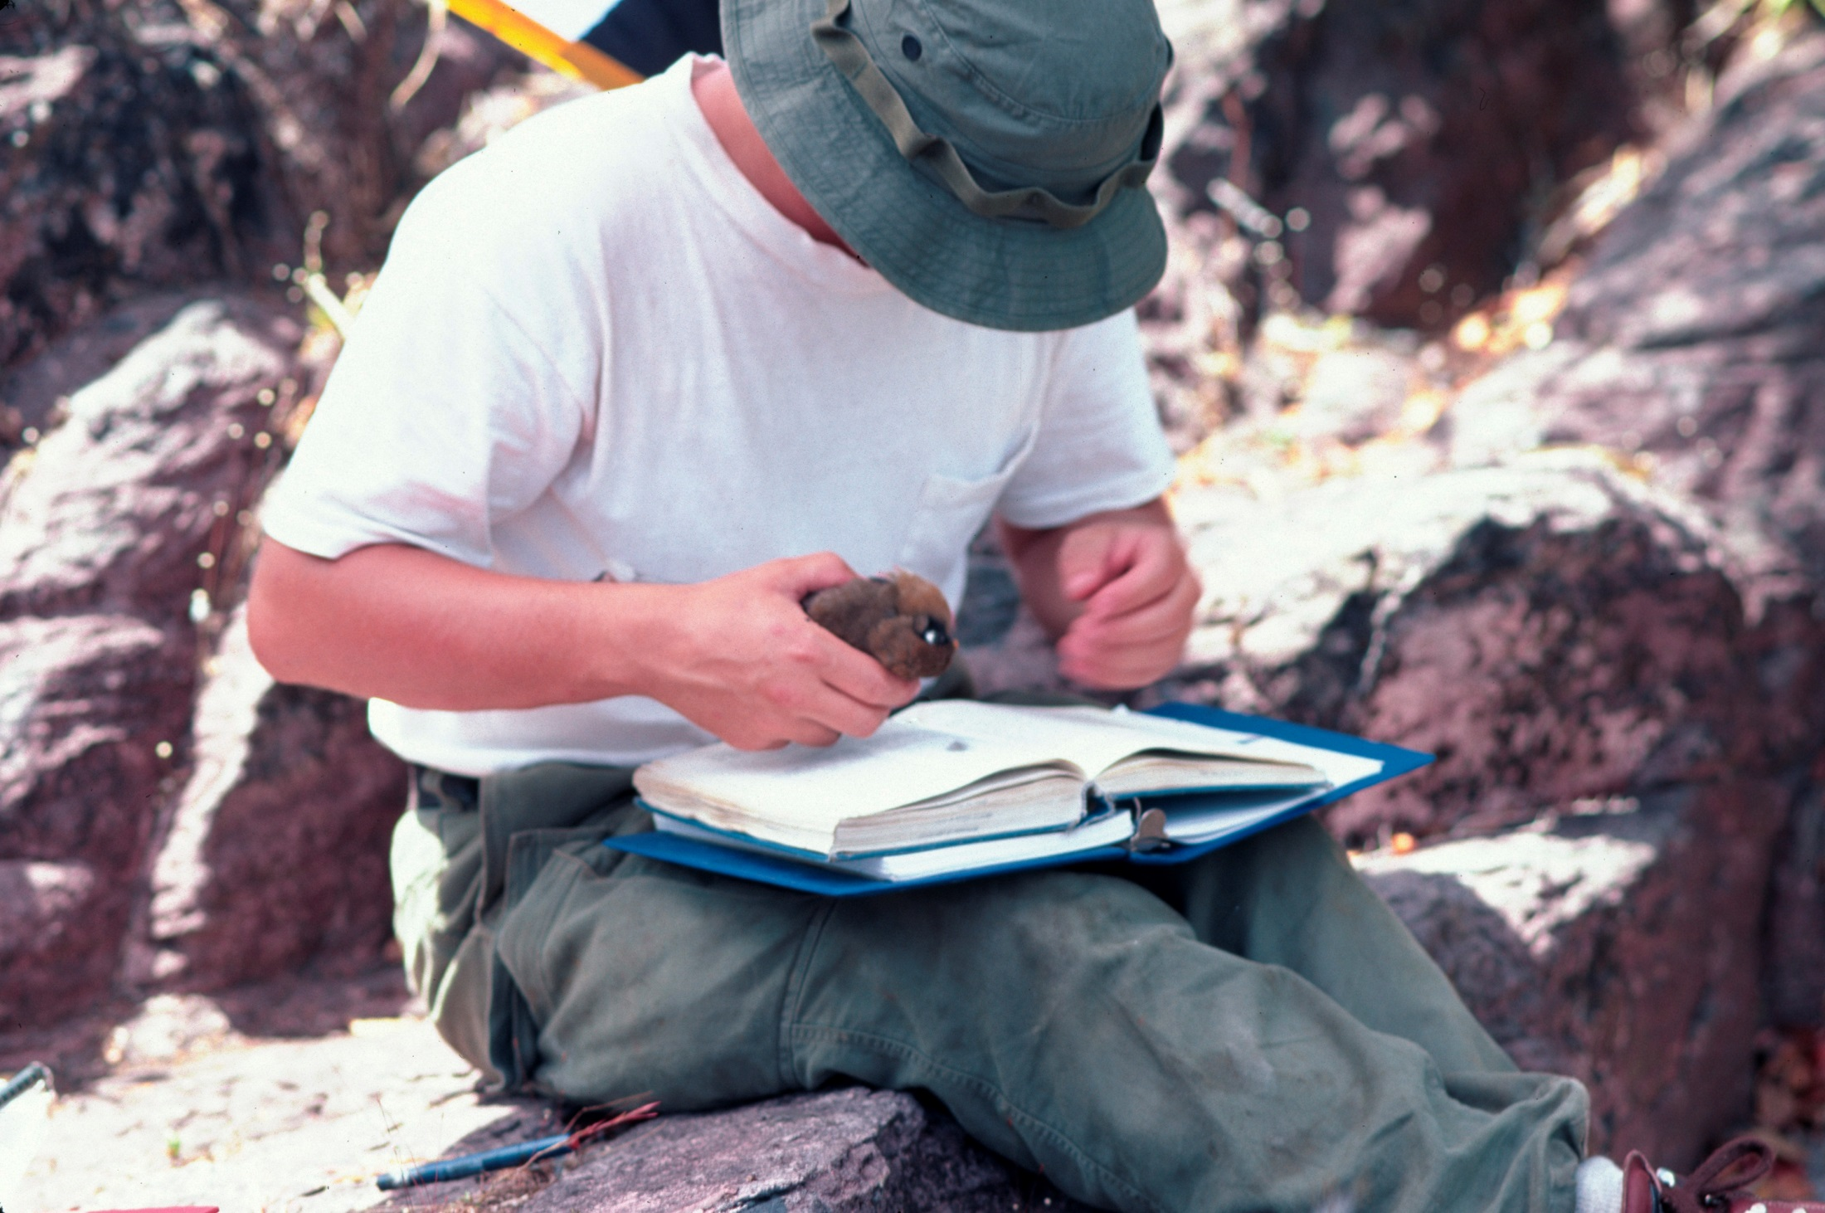
Notes:
Current expeditions are still going to places where using a computer is not practical.
This is Paul Sweet on Explorer21 expedition to Papua New Guinea last fall.
Field books are still a part of field work being done today.

Slide 6
The 3-Dimensions of Biodiversity
ORGANISM
LOCATION
DATE
Rusty Russell, Smithsonian
Notes:
Rusty Russell a Botanist from the Smithsonian and one of the of the original folks behind the Si field book project
3-dimensions of biodiversity
And there are billions of such points represented by individual specimens in collections around the world.
And with these we can monitor change, both temporally and spatially.
It creates the richest, the most complete view of biodiversity on this planet over time. And while we’re making strides toward digitization of organism-location-date records, we have an incredible long road ahead of us.

Slide 7
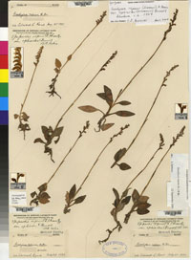
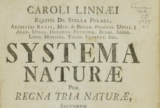
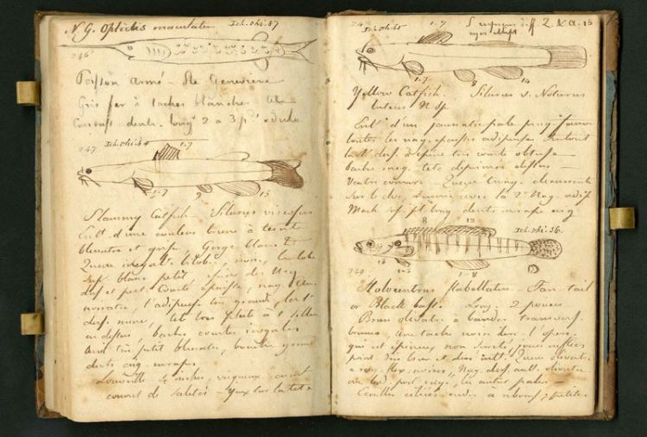
TRAITS
BEHAVIOR
IMAGES
NAMES
ETHNOBIOLOGY
SEQUENCES
SYMBIOSES
Rusty Russell, Smithsonian
Notes:
These represent different kinds of data that scientists are trying to get a better handle on.
They are developing tools to help make these connections more meaningful.
Field books and Science Archives play a central piece to this effort.

Slide 8
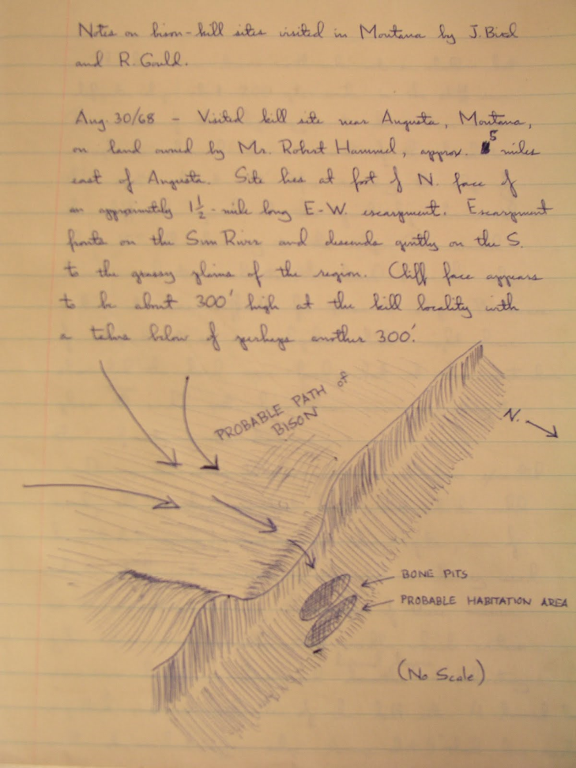
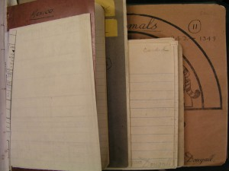
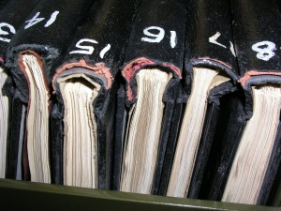
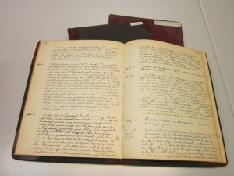
2015 Leon Levy Foundation funded grant to catalog Field Books
Notes:
Starting with Archbold Expeditions in the 30’s – 60’s in Papua New Guinea and the Whitney Expeditions 20’s – 30’s in the Pacific.
The Whitney South Sea Expedition more than 20 years 20’s –30’s
This brings us in line with several other projects with Field books that are happening in other natural history museums.

Slide 9
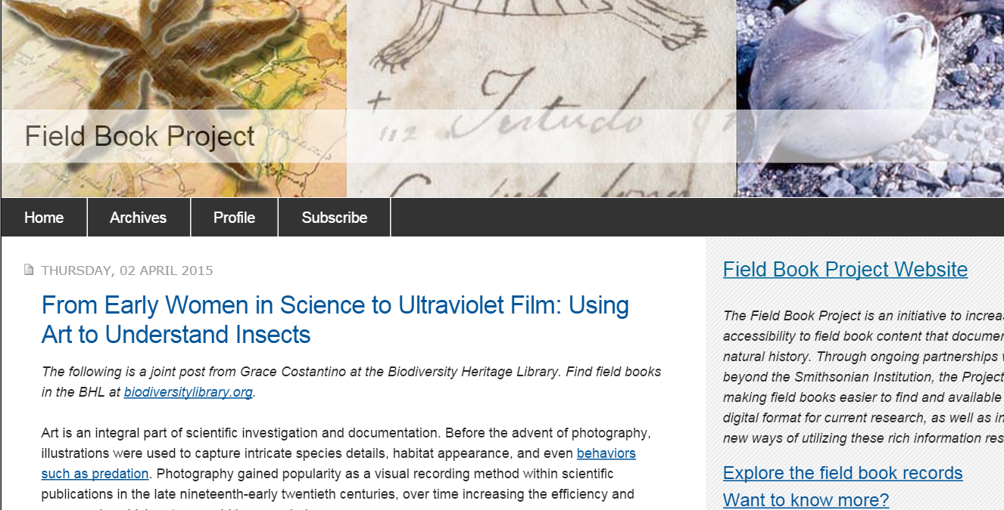
Cataloging and Digitizing
Notes:
5 year project by the Smithsonian

Slide 10
Transcription!
Notes:
We are not here yet but are glad to be moving in this direction.

Slide 11
Preservation but also Access
Notes:
Creators – we owe it to them to preserve but we also owe them access.
This seems straightforward enough until you realize that ownership can be tricky.
Work with creators to ensure locations are captured at the correct level.

Slide 12
Field books turn up in surprising places
Notes:
John Alexander Pope, Director of the Freer Museum of Art – AMNH expedition to Baffin Island 1926
Childs Frick, Paleontologist and son of Henry Clay Frick – Field books from early paleo expeditions at the Frick
Thomas Baillie MacDougall, Horticulturist – Field books supporting Mammal collecting
Frick archives
Nara
NYPL

Slide 13
Who are the keepers?
Notes:
There is a tension in natural history museums as to where these materials should be kept.
With the collections the describe or in the library or archives.
The description and need is different
There are other researchers who might be interested in the data they hold – the archives are a neutral place but they have to be described adequately for discovery.

